Slide 1
IS 120
Web Design

Slide 2
Announcements
Class schedule has changed
Dev Tool Demo sign up coming this week

Slide 3
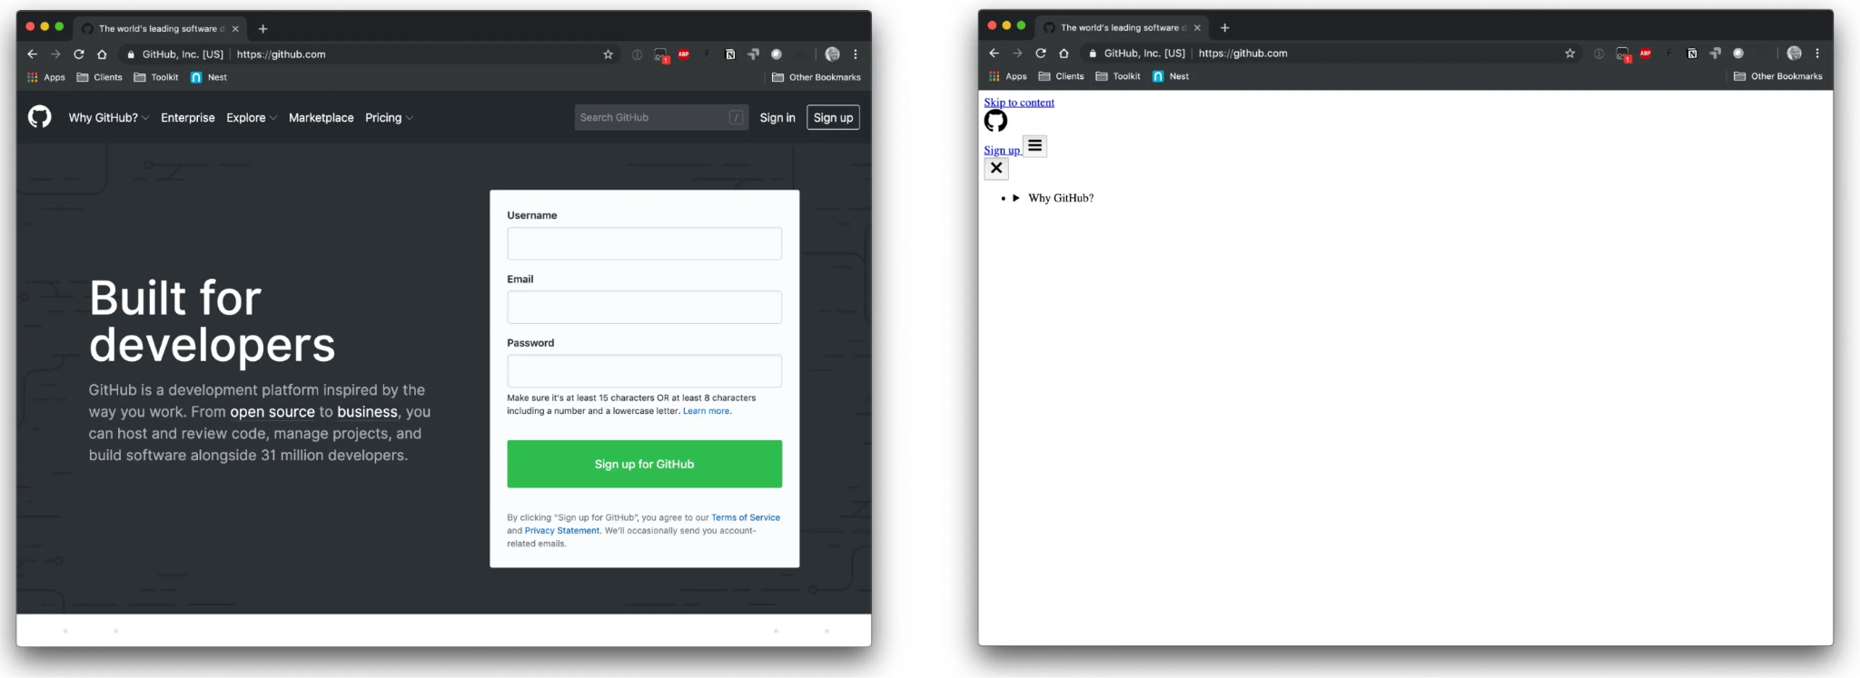
Why care about design?

Slide 4
Why care about design?
Design is the first thing communicated to the user
Users will decide your intent, credibility, and value before even reading a word from your website
Once you learn the right or wrong things to look for, you will see it everywhere

Slide 5
CRAP
Contrast - Repetition - Alignment - Proximity

Slide 6
Contrast

Slide 7
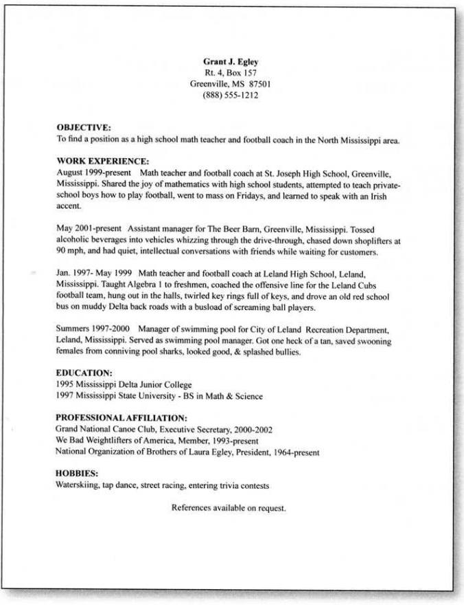
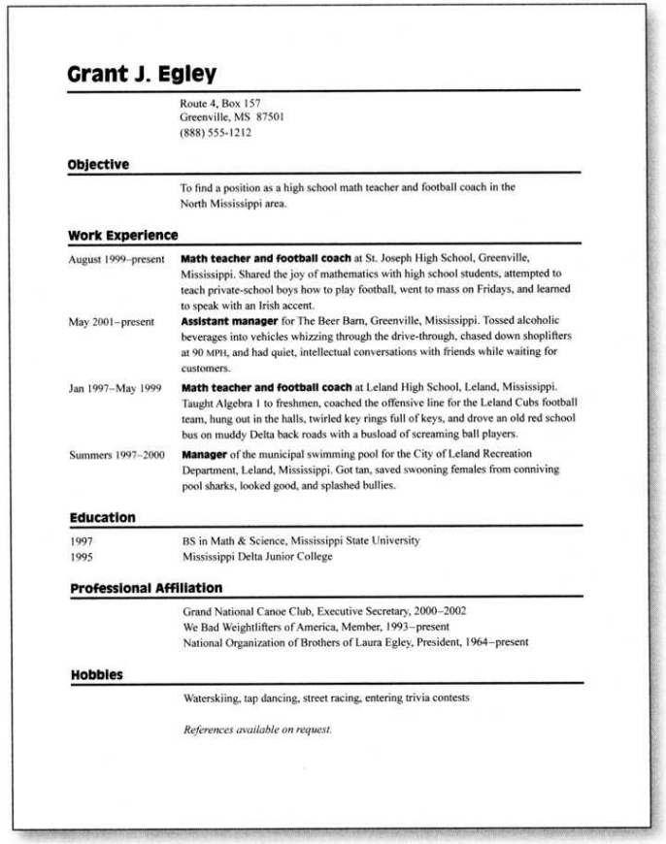

Slide 8



Slide 9



Slide 10
Repetition

Slide 11
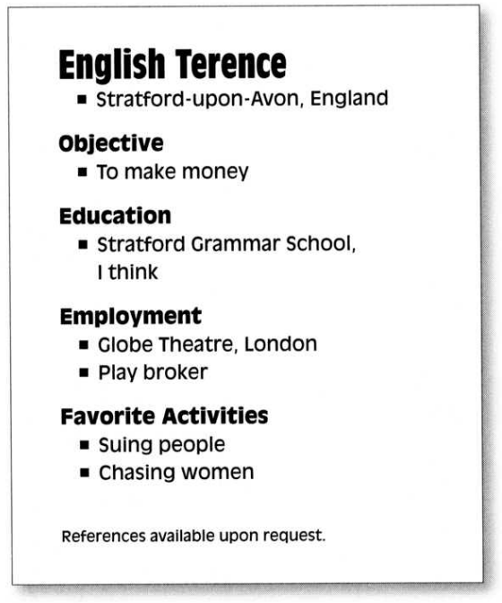

Slide 12


Slide 13
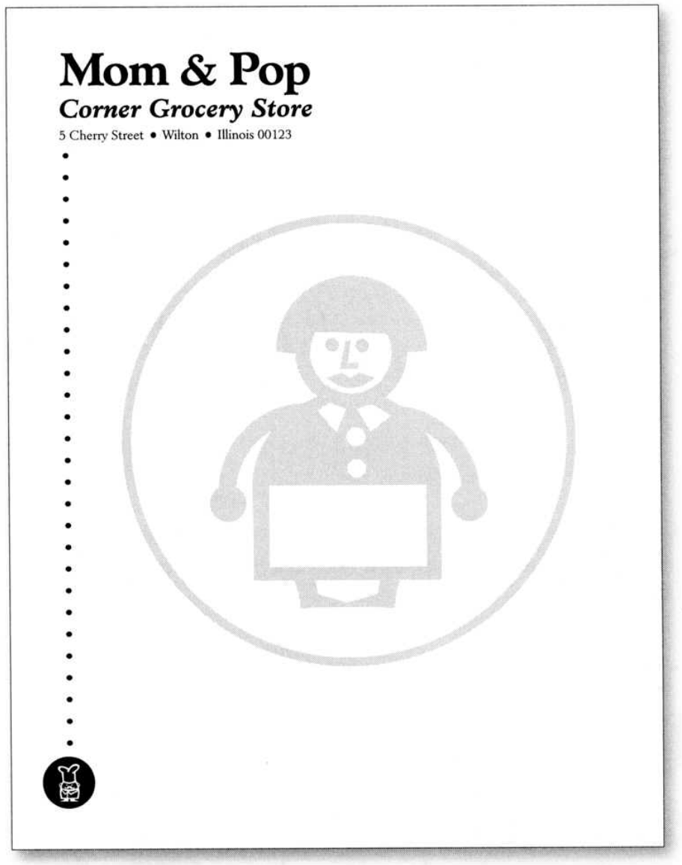

Repetition = Consistency

Slide 14
Alignment

Slide 15
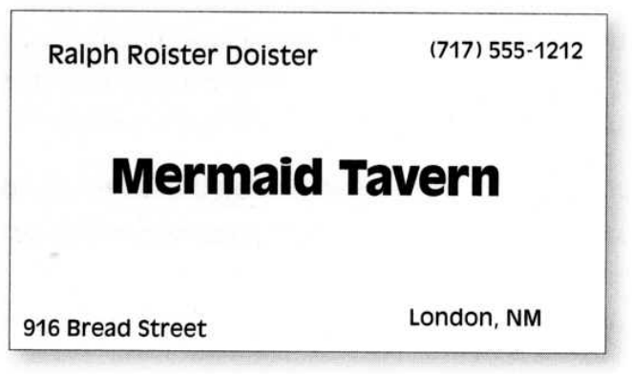
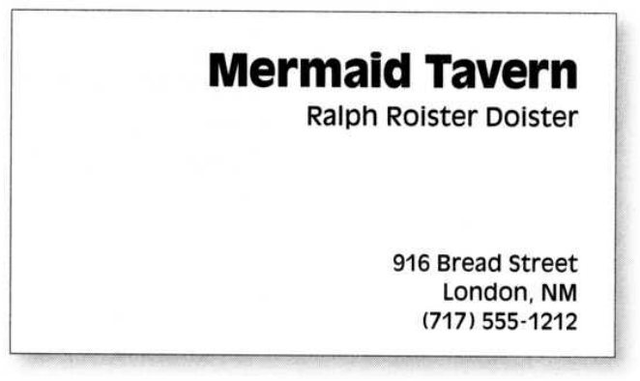
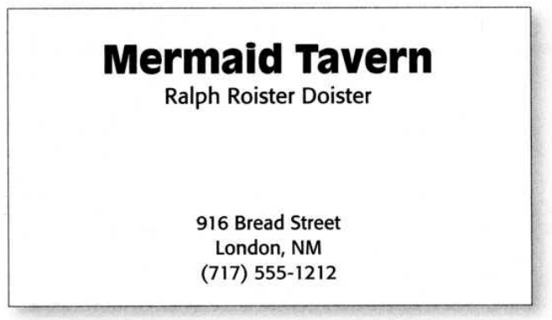

Slide 16
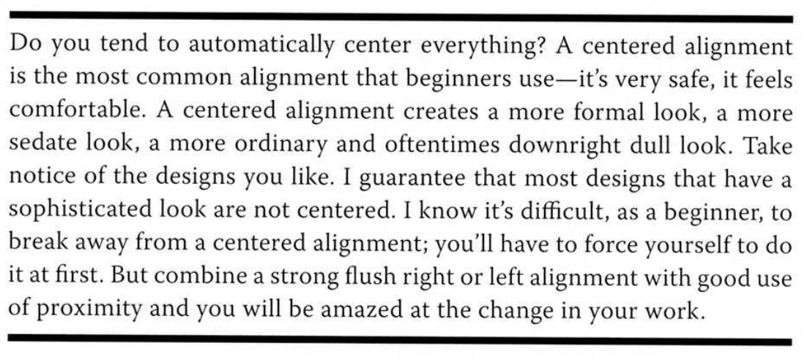

Slide 17



Slide 18
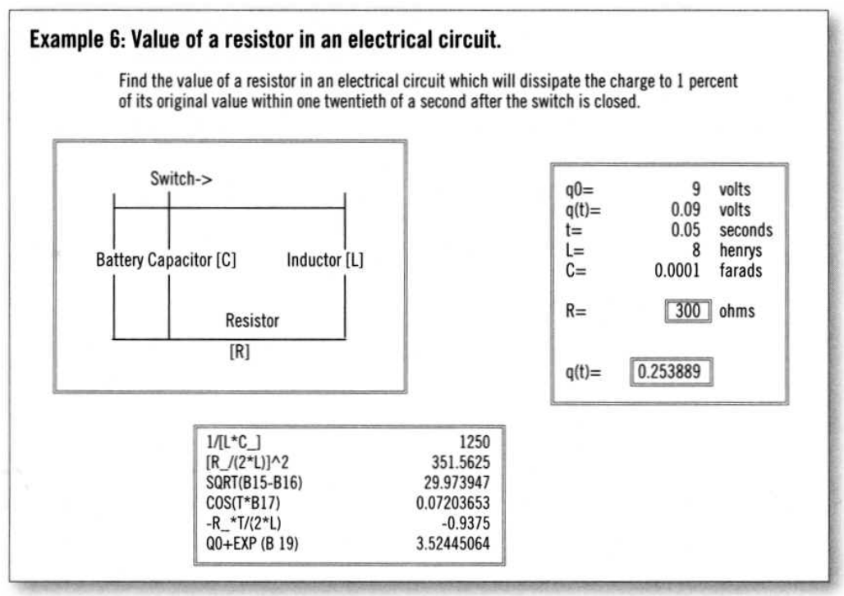
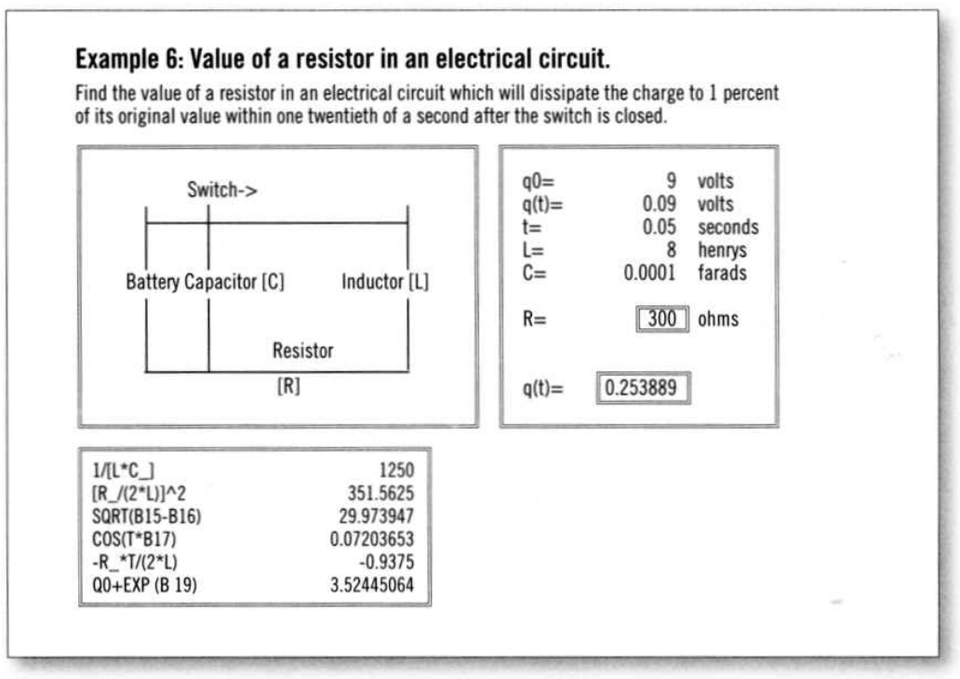

Slide 19
Proximity

Slide 20
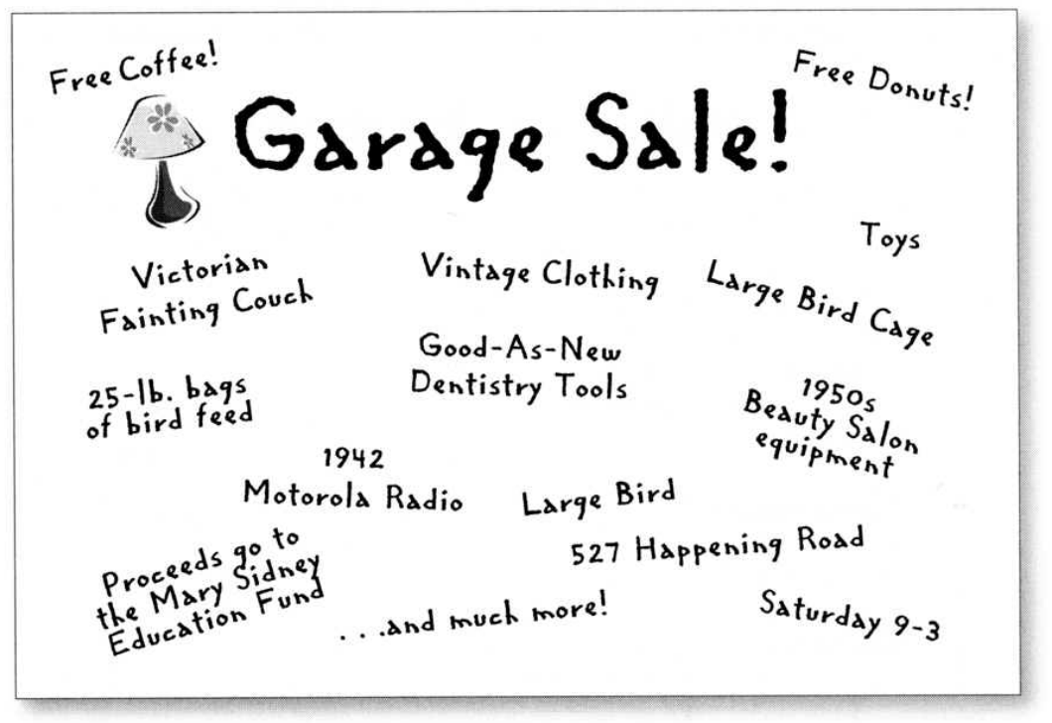
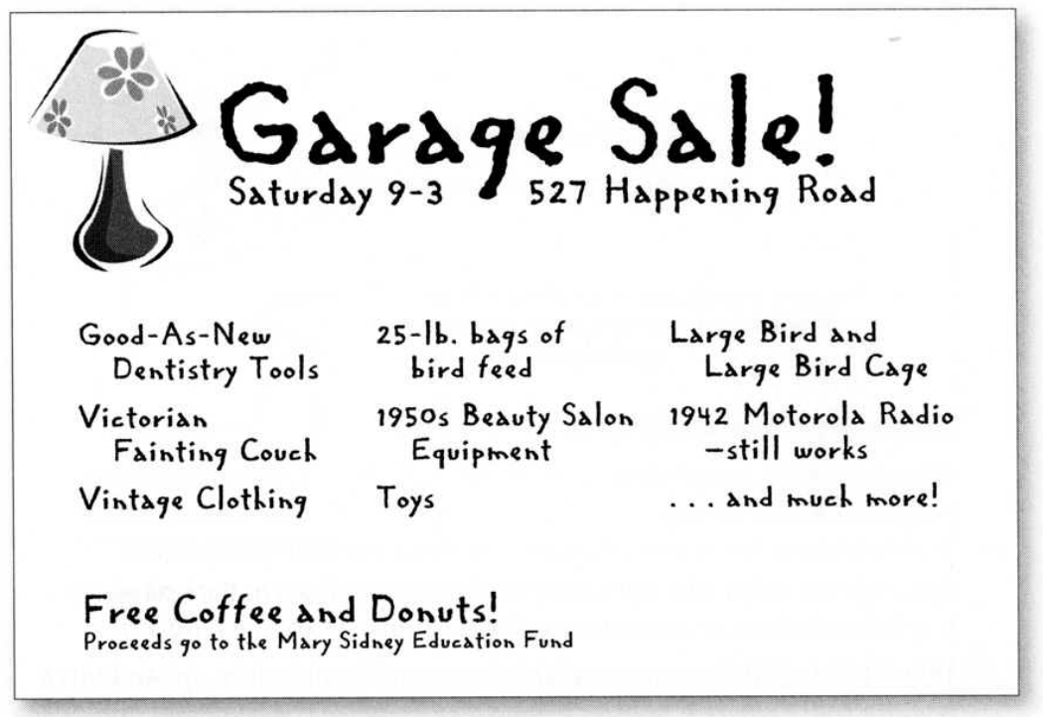

Slide 21

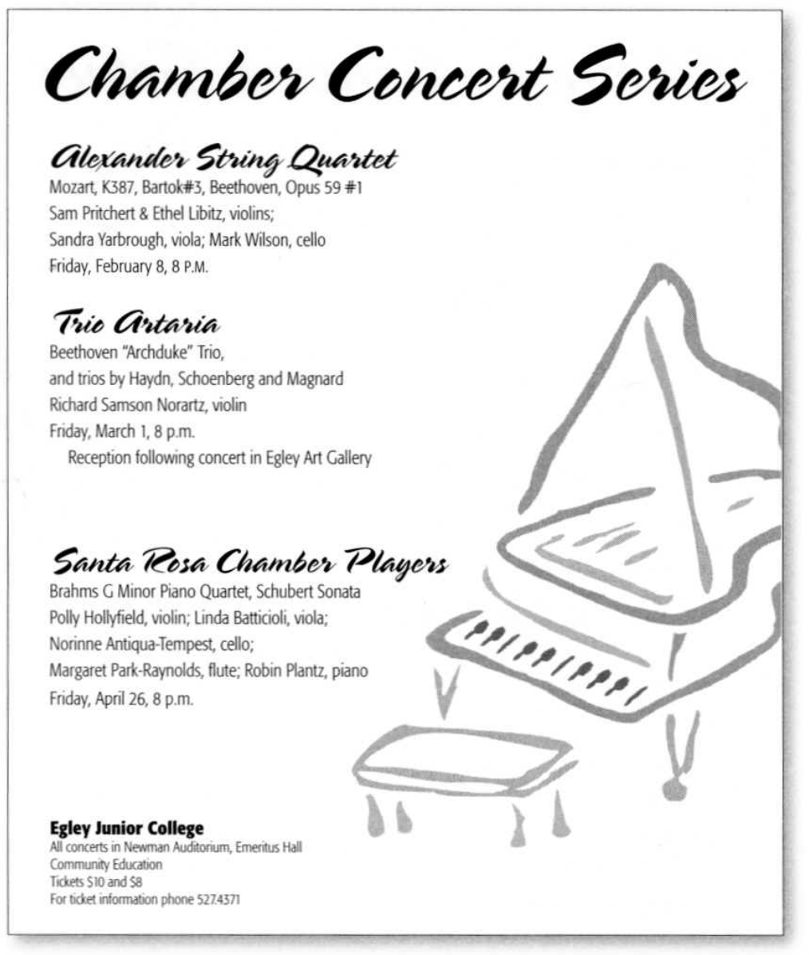

Slide 22
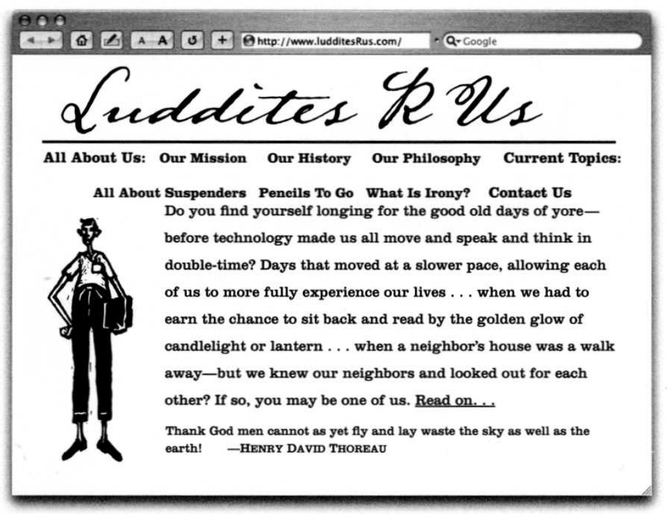
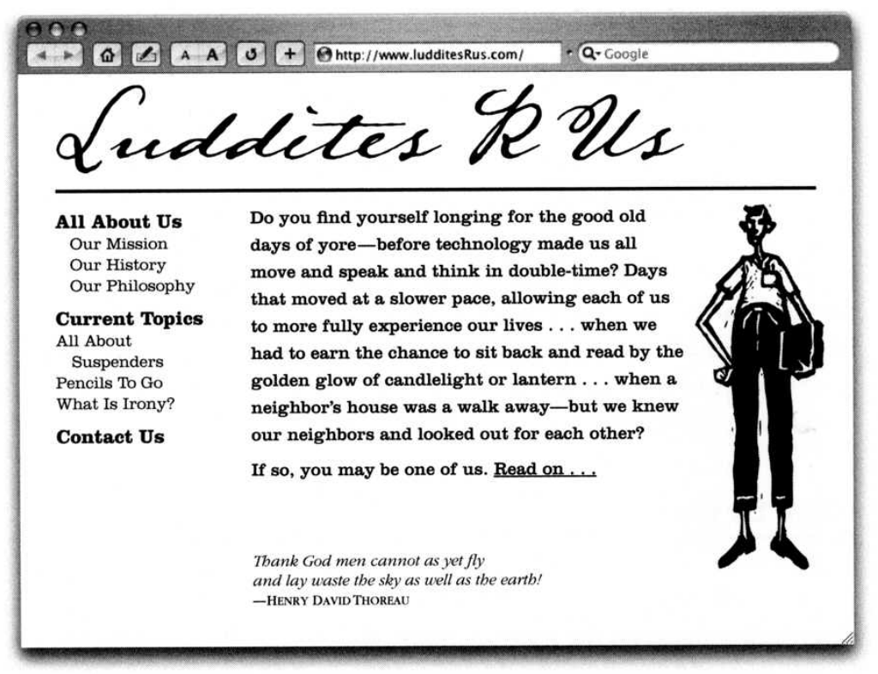

Slide 23
CRAP Examples

Slide 24
60/30/10

Slide 25
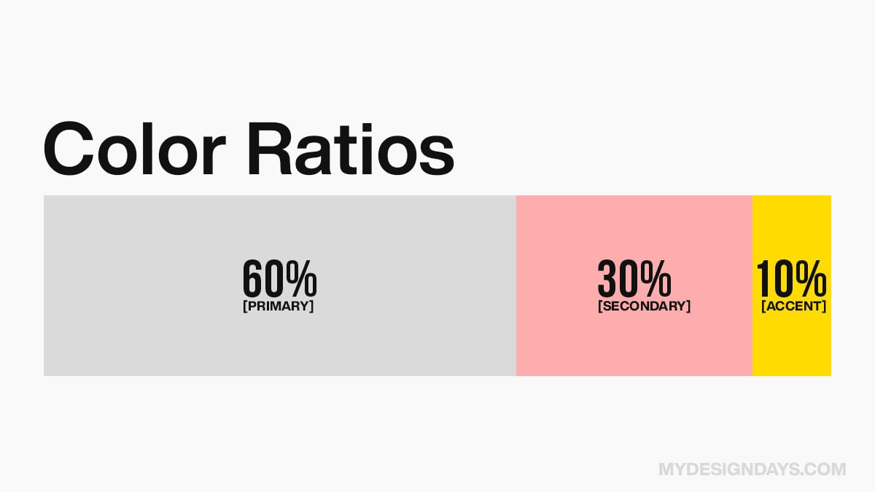

Slide 26
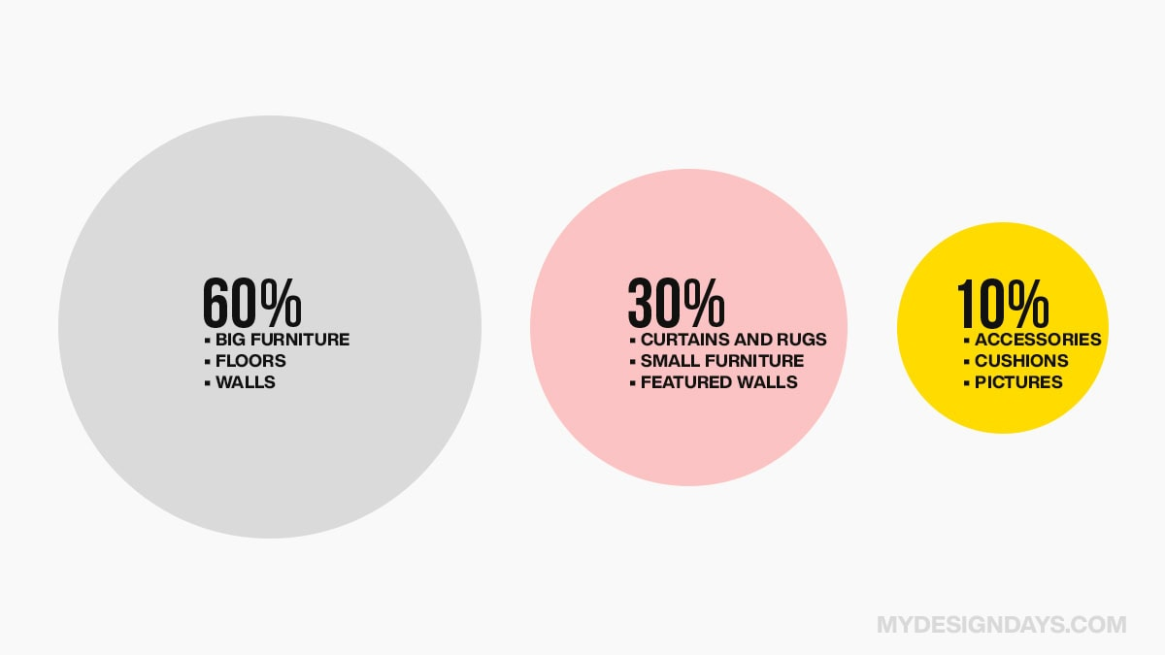

Slide 27
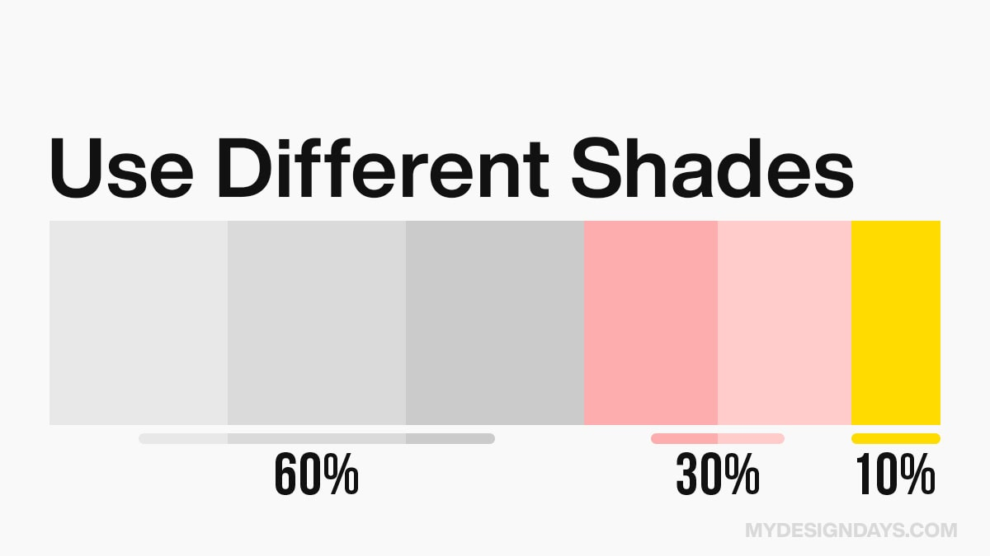

Slide 28
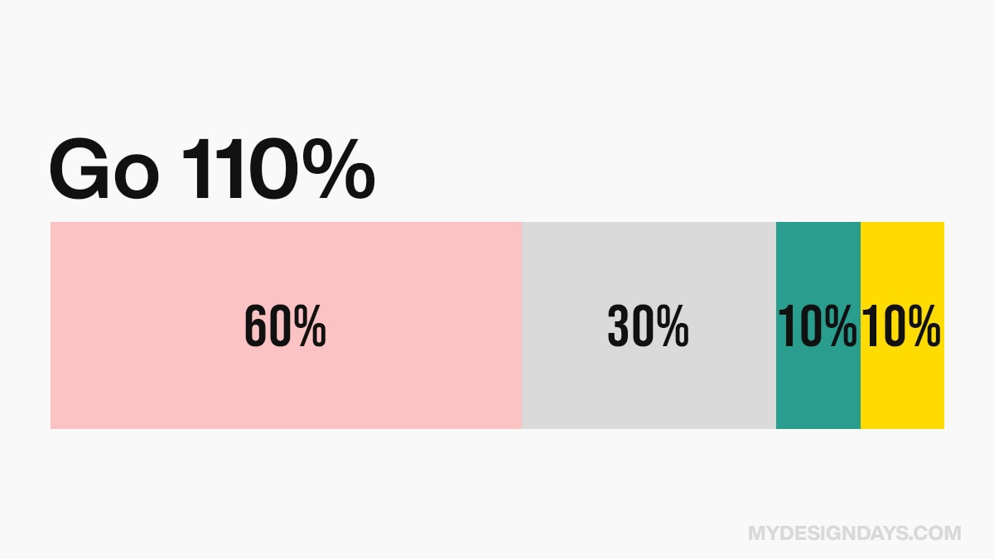

Slide 29
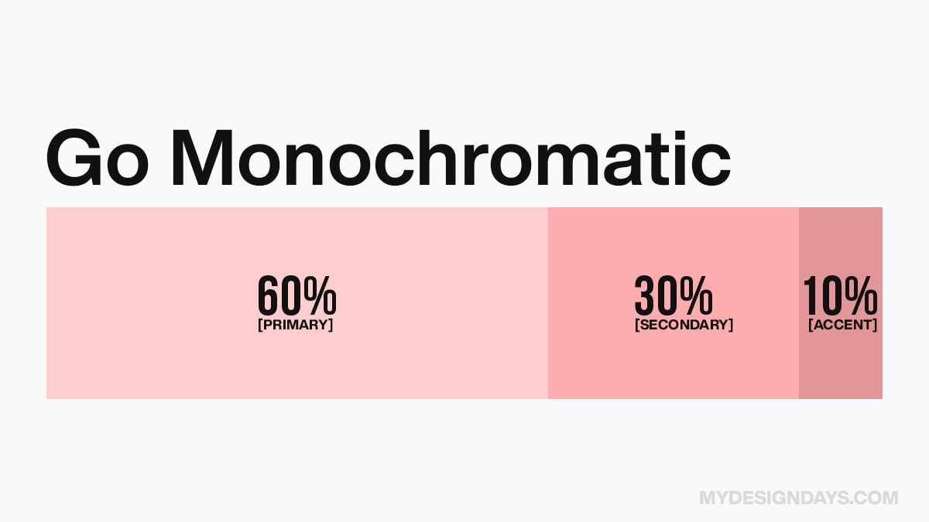

Slide 30
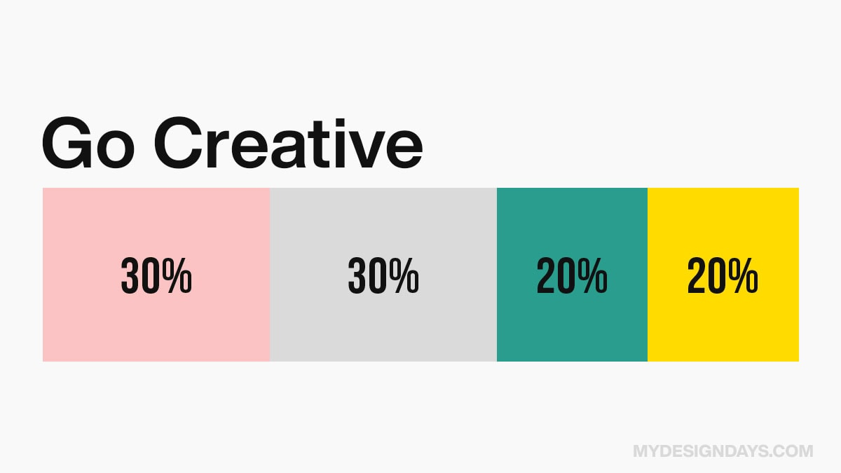

Slide 31
60/30/10 Examples

Slide 32
Less Is More

Slide 33
Find a Website
Take 2 minutes to find a website that you use
Explain how well it does CRAP, 60/30/10, and less is more

